Slide 1
CSE322
Formal Languages and Automation Theory
Lecture #2

Slide 2
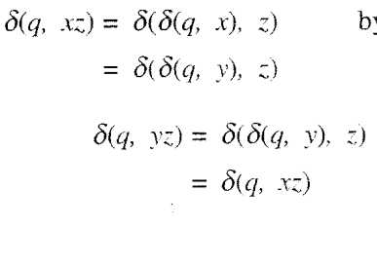

Slide 3

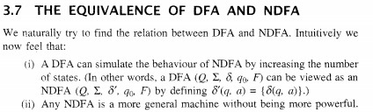

Slide 4

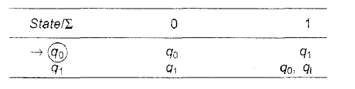
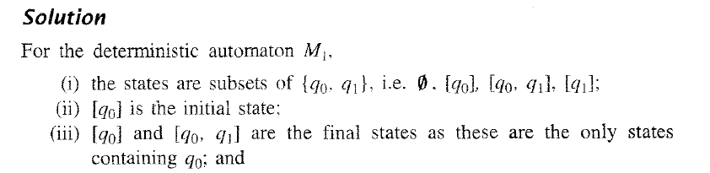

Slide 5
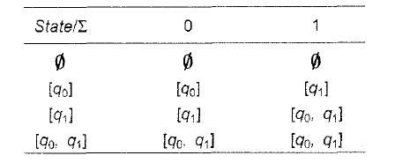

Slide 7
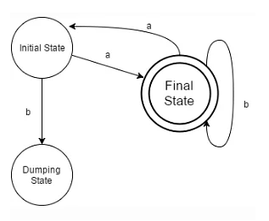
Which of the following will not be accepted by the following DFA?
a) ababaabaa
b) abbbaa
c) abbbaabb
d) abbaabbaa

Slide 8
Answer:A

Slide 9
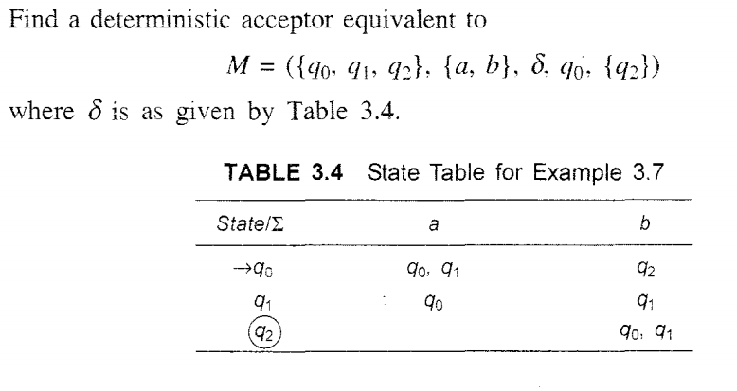

Slide 10
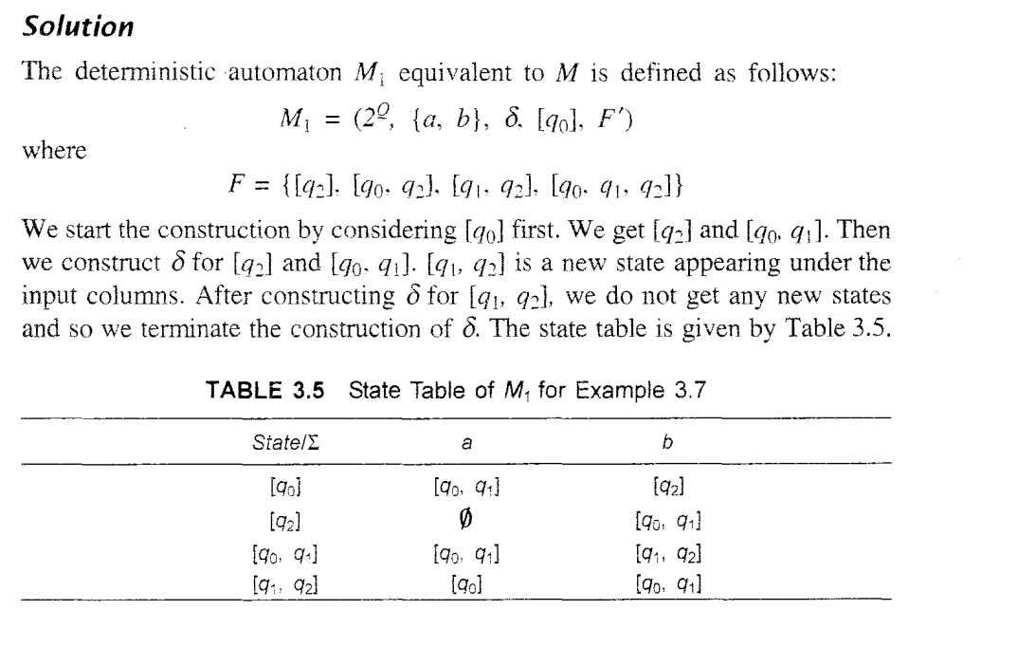

Slide 12
Which of the following will the given DFA won’t accept?
a) ε
b) 11010
c) 10001010
d) String of letter count 11

Slide 13
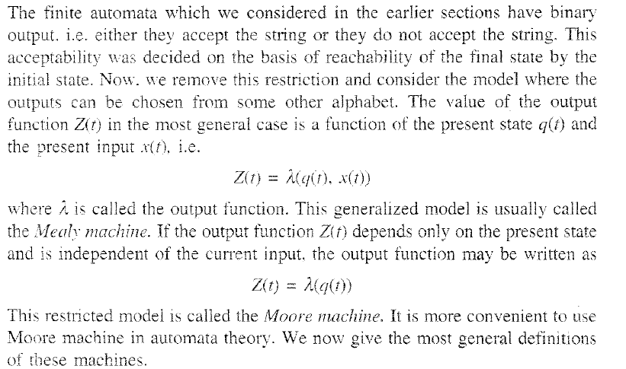

Slide 14
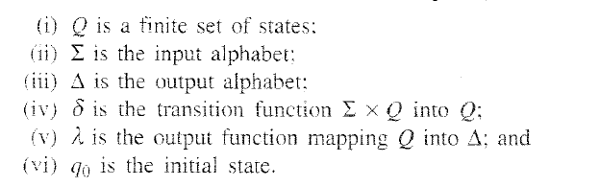

Slide 15
Moore Machine is an application of:
a) Finite automata without input
b) Finite automata with output
c) Non Finite automata with output
d) None of the mentioned

Slide 17

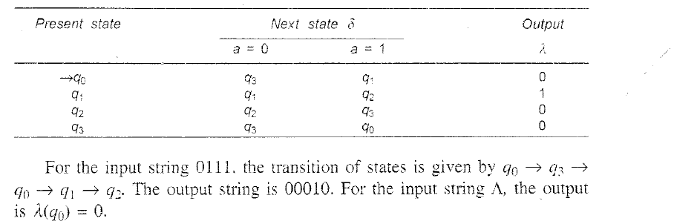

Slide 18
Statement 1: Null string is accepted in Moore Machine.
Statement 2: There are more than 5-Tuples in the definition of Moore Machine.
Choose the correct option:
a) Statement 1 is true and Statement 2 is true
b) Statement 1 is true while Statement 2 is false
c) Statement 1 is false while Statement 2 is true
d) Statement 1 and Statement 2, both are false
View Answer

Slide 19
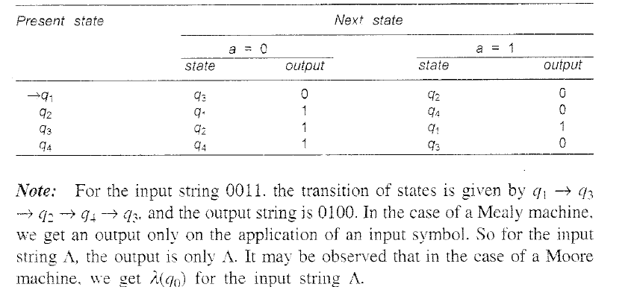

Slide 20
For a give Moore Machine, Given Input=’101010’, thus the output would be of length:
a) |Input|+1
b) |Input|
c) |Input-1|
d) Cannot be predicted

Slide 21
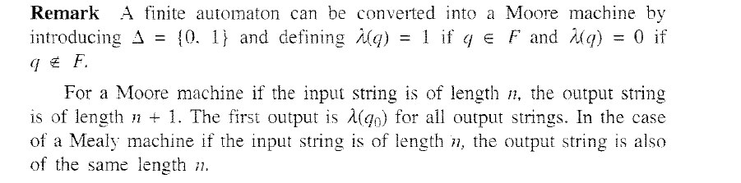

Slide 22
In mealy machine, the O/P depends upon?
a) State
b) Previous State
c) State and Input
d) Only Input

Slide 23
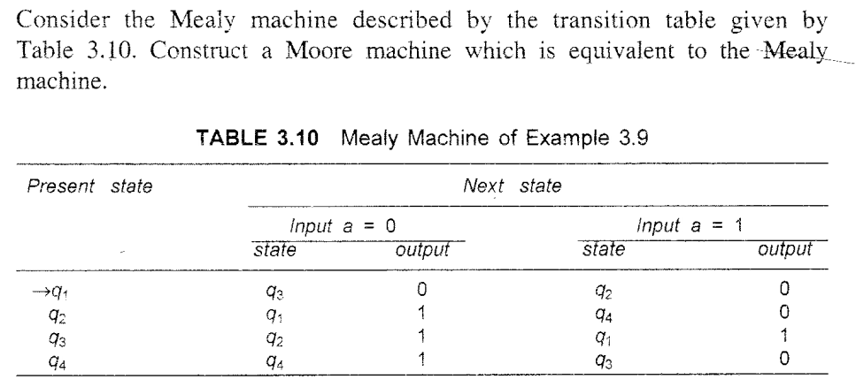

Slide 24
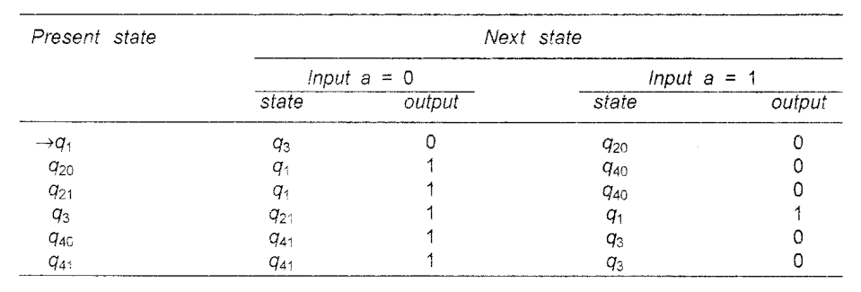
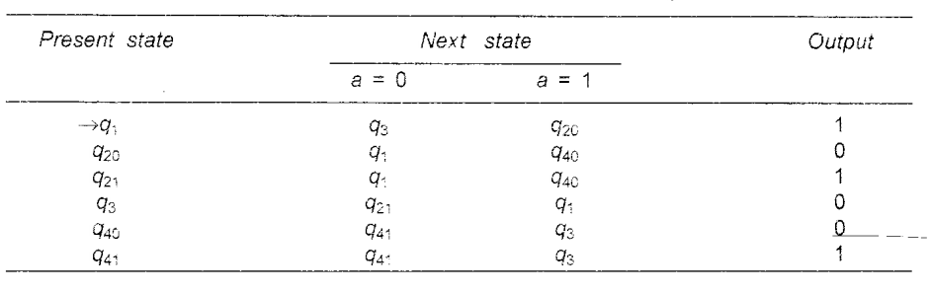

Slide 25
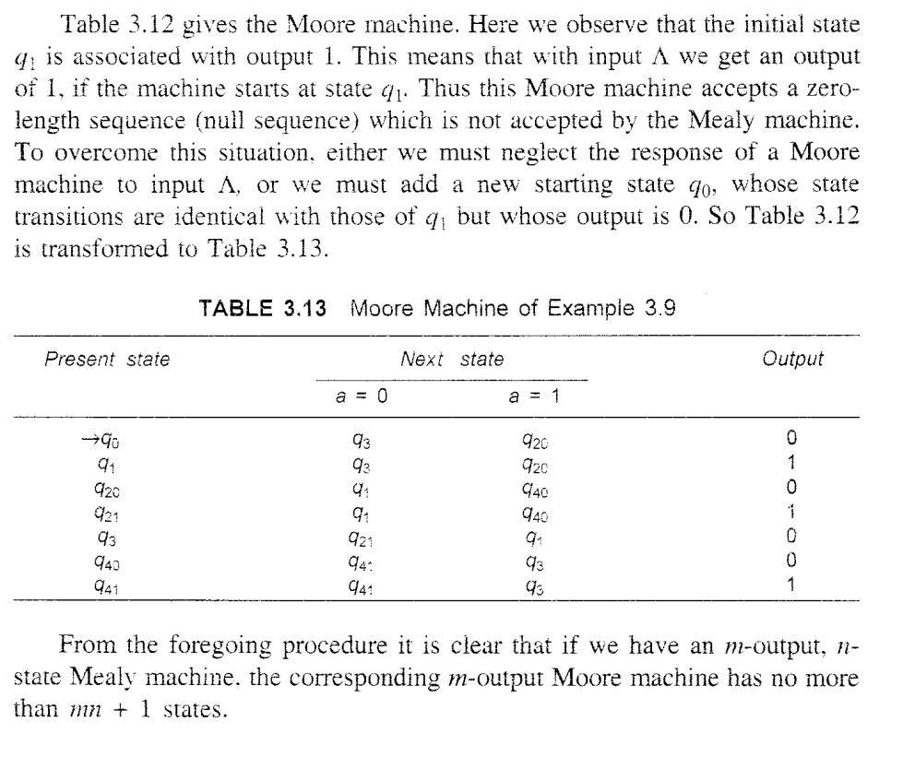

Slide 26
Which of the following is a correct statement?
a) Moore machine has no accepting states
b) Mealy machine has accepting states
c) We can convert Mealy to Moore but not vice versa
d) All of the mentioned

Slide 27


Slide 28
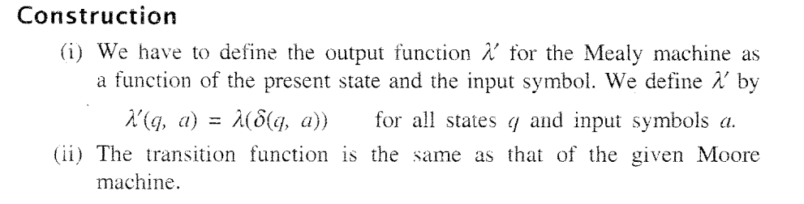

Slide 29
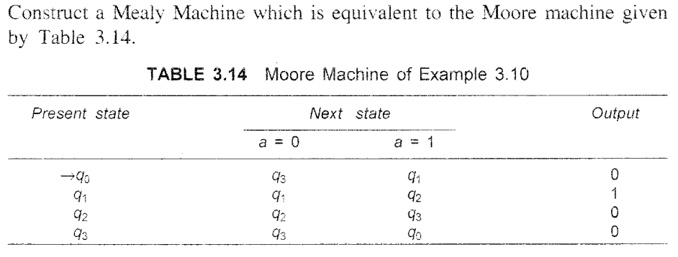

Slide 30
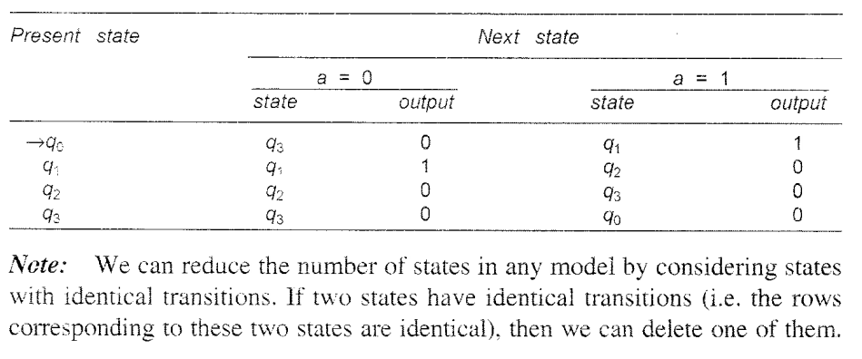

Slide 32
Which of the given are correct?
a) Moore machine has 6-tuples
b) Mealy machine has 6-tuples
c) Both Mealy and Moore has 6-tuples
d) None of the mentioned

Slide 33
In mealy machine, the O/P depends upon?
a) State
b) Previous State
c) State and Input
d) Only Input

Slide 34
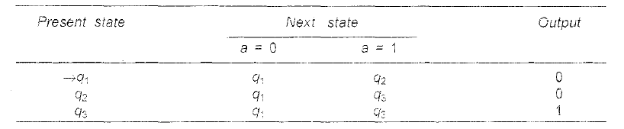

Slide 35
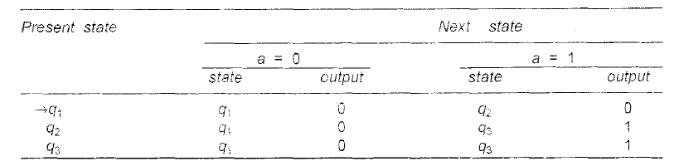
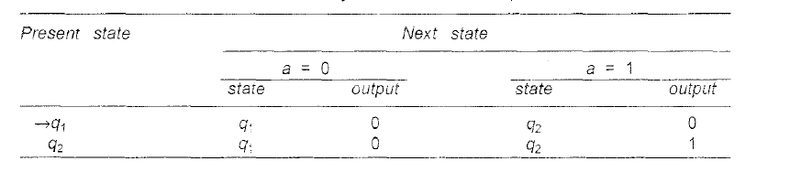

Slide 36


Slide 37
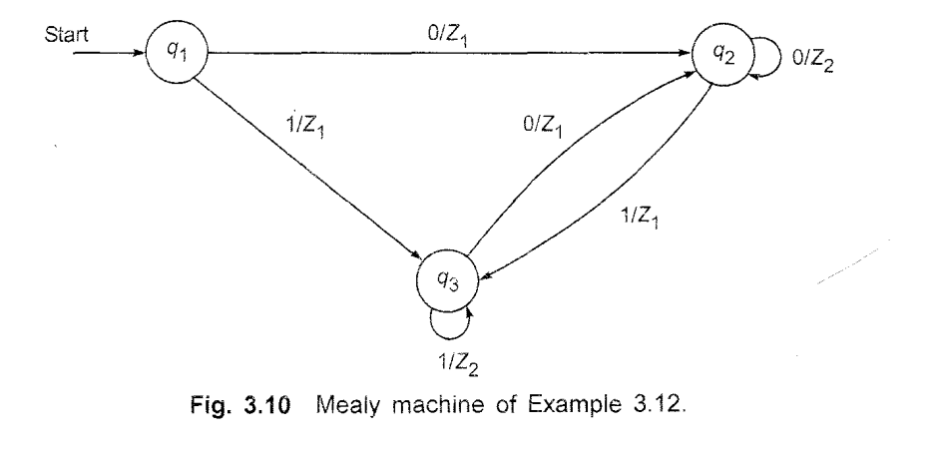

Slide 38
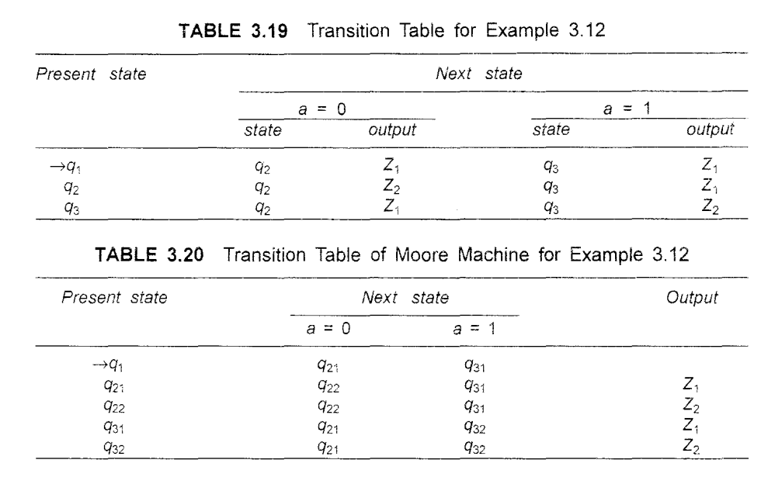

Slide 40
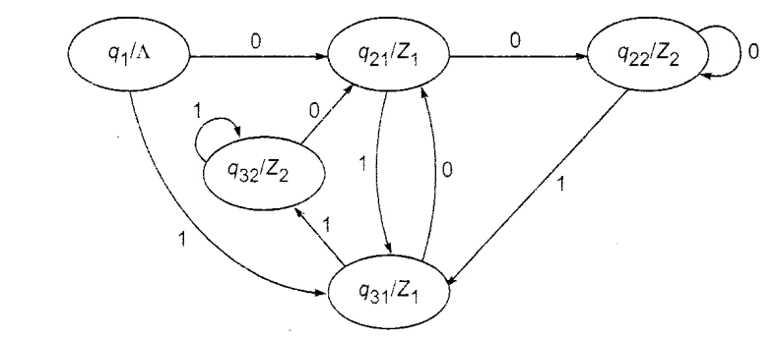

Slide 41
The ratio of number of input to the number of output in a mealy machine can be given as:
a) 1
b) n: n+1
c) n+1: n
d) none of the mentioned

Slide 42
The major difference between Mealy and Moore machine is about:
a) Output Variations
b) Input Variations
c) All of the mentioned
d) None of the mentioned

Slide 43
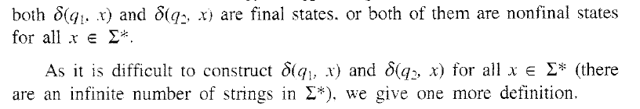


Slide 44



Slide 45
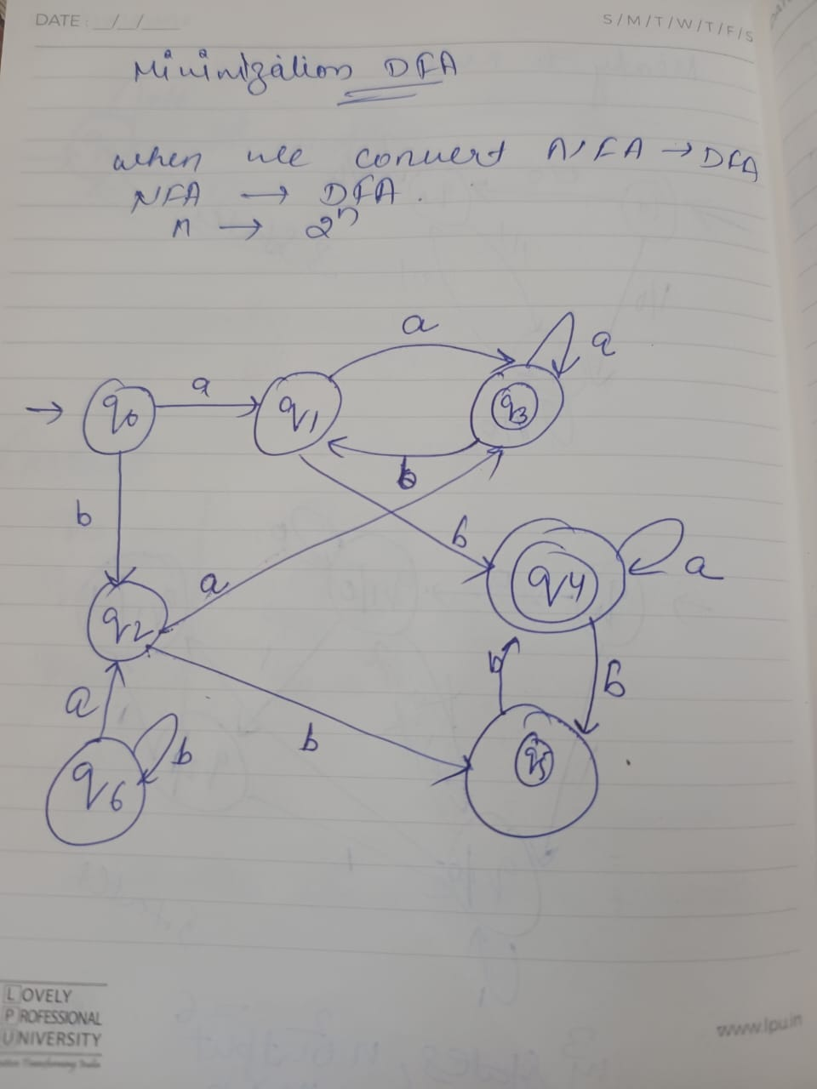

Slide 46
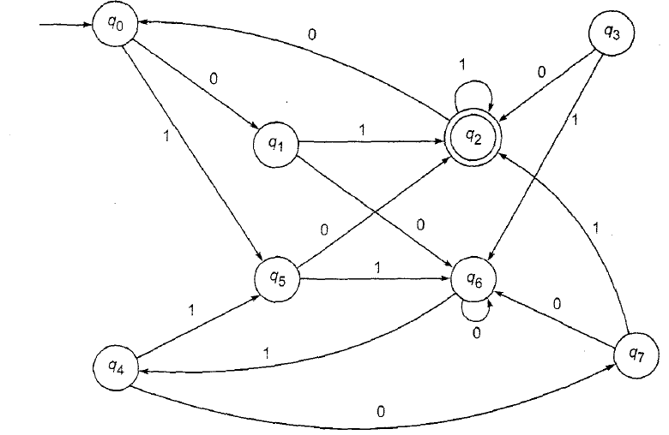

Slide 47
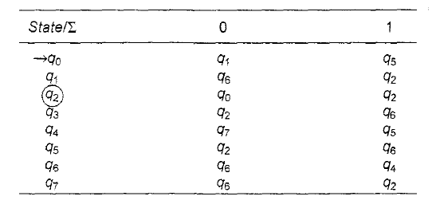

Slide 49

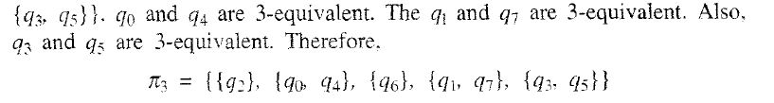

Slide 51
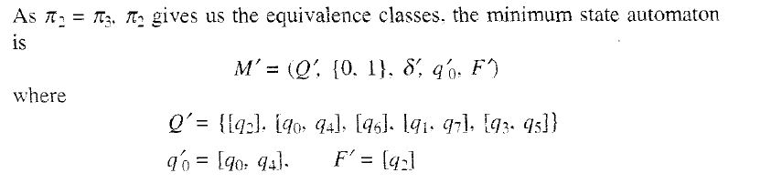
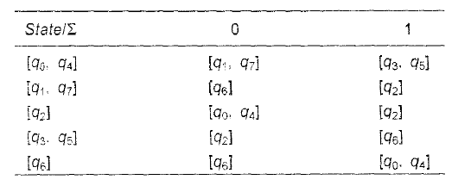

Slide 52
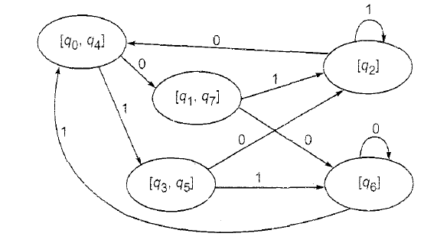

Slide 53
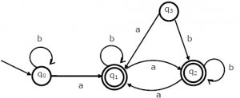
The minimum state automation equivalent to the below FSA has the following number of states?
a) 1
b) 2
c) 3
d) 4

Slide 54
Answer: b
Explanation: State q0 can be omitted because it takes the same input as state q1 hence by removing q0 nothing changes.

Slide 55
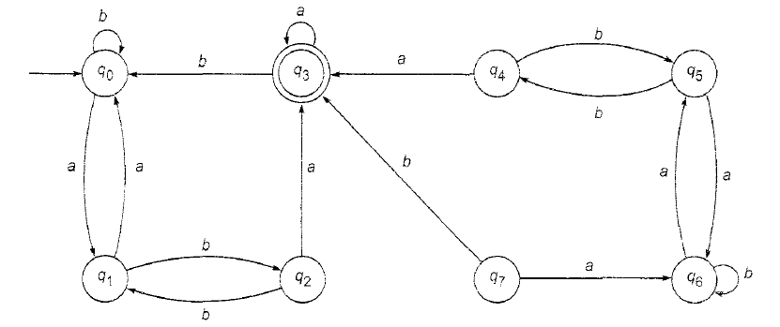

Slide 56
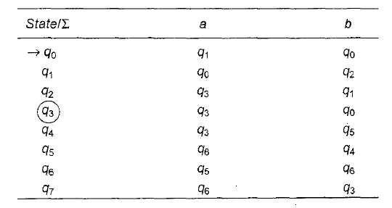

Slide 58
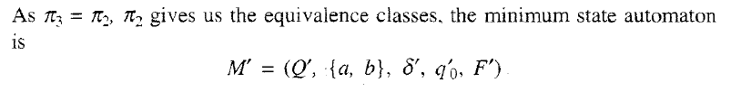

Slide 60

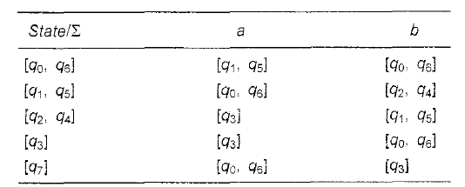

Slide 61
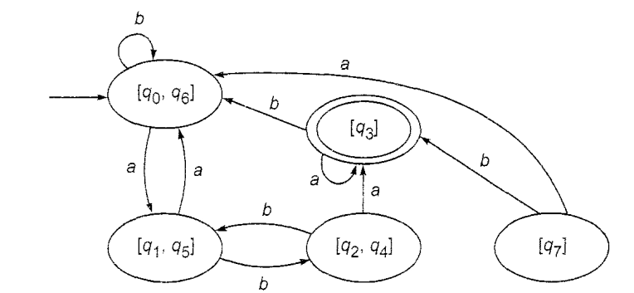

Slide 62
Language of finite automata is.
a) Type 0
b) Type 1
c) Type 2
d) Type 3

Slide 63
Answer:d
Explanation: According to Chomsky classification.

Slide 64
Number of final state require to accept Φ in minimal finite automata.
a) 1
b) 2
c) 3
d) None of the mentioned

Slide 65
What is a Finite Automaton?
A machine with infinite states
A machine that can solve any computational problem
A machine that only accepts binary inputs
None of above
Notes:
b

